Slide 1

2022

Slide 2
Introductory Python for Data Science

Slide 3
Agenda
Learning outcomes
Course contents
Questions

Slide 4
Learning outcomes
Provides the basic programming skills necessary to complete the Data Science & AI program pre-work
Basic skills in programming in Python for data science including:
Use Jupyter Notebook to write and run Python code
Find and read the Python documentation for libraries and functions
Work with basic Python data types (string, float, integer, list, etc.)
Write Python expressions that involve variables, variable assignment, operators and functions
Use Python conditional and loop functions
Resolve coding errors
Create basic graphs
Read, clean and manage data
Notes:
Add detailed learning outcomes

Slide 5
Course contents
Overview
Programming as a problem-solving technique
Lab 1
Python environments, tools and key libraries
Lab 2
Data analysis in Python and data analysis projects
Lab 3
Summary and call for action

Slide 6
Questions

Slide 7
Introductory Python for Data Science
Module 1
Programming as problem-solving

Slide 8
Agenda
What is programming?
Importance of programming for data science
Python Fundamentals
Developing and running Python
Input and output function options
Data structures in Python
Writing functions in Python
Iterating in Python

Slide 9
What is programming?
Programming is:
the process of creating a set of instructions that tell a computer how to perform a task.
thinking systematically and critically
breaking a task into steps. Examples include: a recipe, directions to a destination and mathematical problem solving
A program usually takes an input and produce an output
You can think of programming as a way to solve a problem to generate the required output from a given input
Difference between programming and coding?
Programming is the skill to specify a program independent of any programming language
Coding is writing the program in a specific programming language

Slide 10
Programming is a fundamental skill for data science
Data science involves problem solving at many levels and in each step of a project in an implicit (conceptual) or explicit form (programs)
Programming, which is the main tool for data science, can be defined in its essential form as a problem-solving technique for data-driven problems
Python is the most popular programming language for data science

Slide 11
Problem solving
Problem solving is the process of finding solutions to difficult or complex issue
Scientific method involves stating problems in a manner that facilitate solving them mathematically and verify them empirically
Problems can be solved using techniques that include a combination of the following actions:
Define
Decompose
Search
Validate

Slide 12
An approach for problem solving
Is there a problem?
Start
No
Problem solved
Yes
Is the problem well-defined?
Give up?
No
Yes
Problem not solved
Yes
No
Yes
Define
(Shape, refine, reframe)
Is the problem simple enough?
Solution found?
Yes
Search
(Trial & error, analogy, …)
No
No
Yes
No
Solution verified?
Decompose
(and iterate)
Verify
(Proof, diagnose, …)
Yes

Slide 13
Python programming language
Python is a high-level programming language, and its core design philosophy is all about code readability and a syntax which allows programmers to express concepts in a few lines of code
Python is used for developing many different types of computer programs including:
Data analysis
Data visualisation
Machine learning

Slide 14
Python comments
Single line comment
# This is a comment
Multiple line comments
“””
Multiple line comment
“””

Slide 15
Python input and output functions
Input function receives an input from the user
Data = input(‘Please enter your name:’)
Print function prints formatted text and variables
A = 100
Print(f”This is a text and embedded variable {A}”)

Slide 16
Python variables and data types
Variables are used to store information to be referenced and manipulated in a computer program.
Common data types
Integer <int> examples: 1, 1095, -2
Float <float> examples: 1.2, - 2974.074
String <str> examples: ‘Bob, “This is a longer string \t with special char’s”
Boolean <bool> examples: True, False
Python allows you to convert variables between these types when needed
Type command
type(12.65) -> <class 'float'>

Slide 17
Python operations
Math operations
+ plus - minus / divide * multiply
< less-than > greater-than <= less-than-equal
>= greater-than-equal
Logic operations
and, or, not

Slide 18
If/else, for loops, while loops
The if/else statement executes a block of code if a specified condition is true. If condition is not met, another block of code can be executed.
Loops through a block of code a number of times
Loops through a block of code while a specified condition is met
continue
break
pass
var = 10
if (var >= 5):
print('var is greater than or equal 5')
elif (var < 0):
print('var is negative')
elif (var == 0):
print('var is zero')
else:
print('var is less than 5')
for i in range(10):
print(i)
var = 10
while(var < 20):
print('var is less than 20')
var+=2

Slide 19
Data structures
lists
A list is the Python equivalent of an array, but is resizable and can contain elements of different types
Functions: append, extend, insert, remove, pop, clear, index, count, sort, reverse, copy
comprehensions
tuples
A tuple is an (immutable) ordered list of values.
sets
A set is an unordered collection with no duplicate elements.
dictionaries
A dictionary stores (key, value) pairs
Tuple_x = (2, 7)
List_y = [2, 4, 6, 8]
Dictionary_z = {”id”: 123, “name”: “Item 123”}

Slide 20
Functions
def funcName(param1, param2, defArg1 = 0, defArg2 = 100):
# code here
return someResult
Optional parameters take default arguments if missing from function call
Arguments are assigned to parameters in defined sequence unless named in call
return statement
optional
can return multiple items
scope is inherited from main (but not from a calling function)

Slide 21
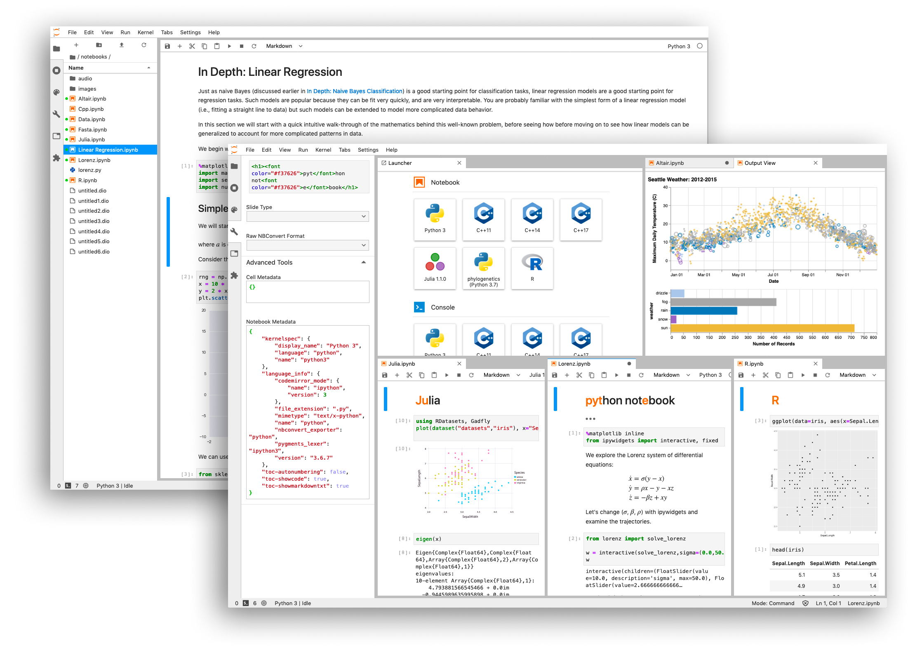
Jupyter notebook
The Jupyter notebook is an open-source web application that allows you to create and share documents that contain live code, equations, visualisations and narrative text
We will use Jupyter notebooks for exercises in this course

Slide 22
Lab 1: First Python program
Read and follow the instructions in the notebook

Slide 23
Introductory Python for Data Science
Module 2
Python environment, tools and libraries

Slide 24
Agenda
Python environment
Python tools
Python libraries

Slide 25
Environments
What is an environment?
A practical way to deal with Python’s packages (libraries)
Issues:
Many packages have not been around long enough to be tested with other packages that you might want to use with them
Packages don’t always get updated quickly in response to updated dependencies
Solution:
Create virtual environments for hosting isolated projects using Anaconda Navigator

Slide 26
Installing Packages with pip
install a package
upgrade a package
install a specific version
install a set of requirements
install from an alternate index
install from a local archive
$ pip install anypkg
$ pip install --upgrade anypkg
$ pip install anypkg==1.0.4
$ pip install -r reqsfile.txt
$ pip install --index-url http://my.package.repo/simple/ anypkg
$ pip install ./downloads/anypkg-1.0.1.tar.gz

Slide 27
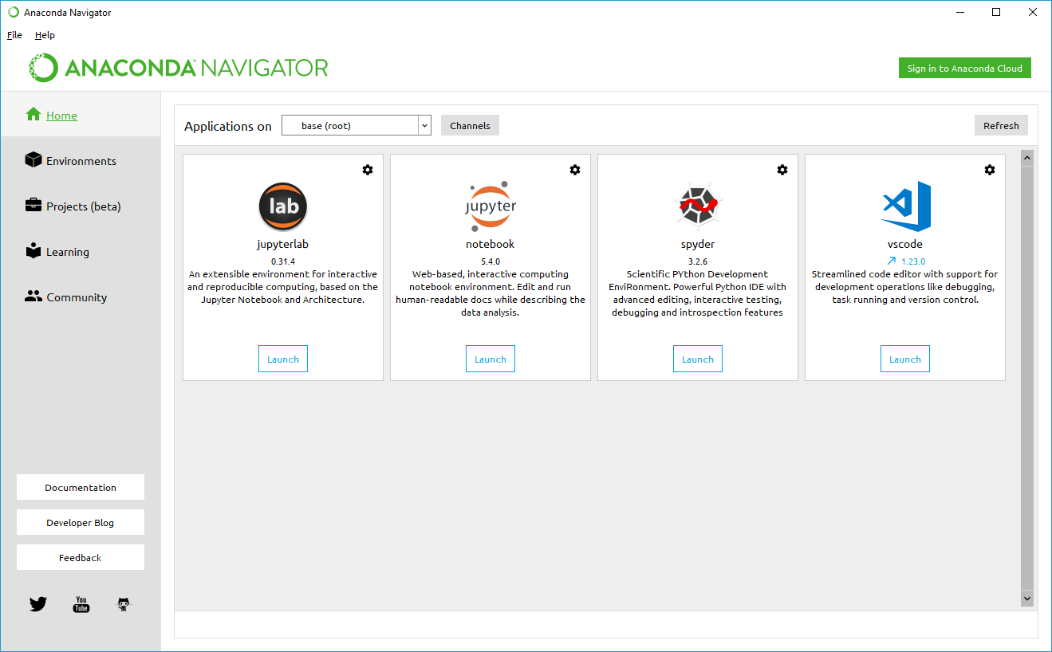
Anaconda
Anaconda Distribution is the recommended way to configure and manage your Python development and running environment(s).

Slide 28
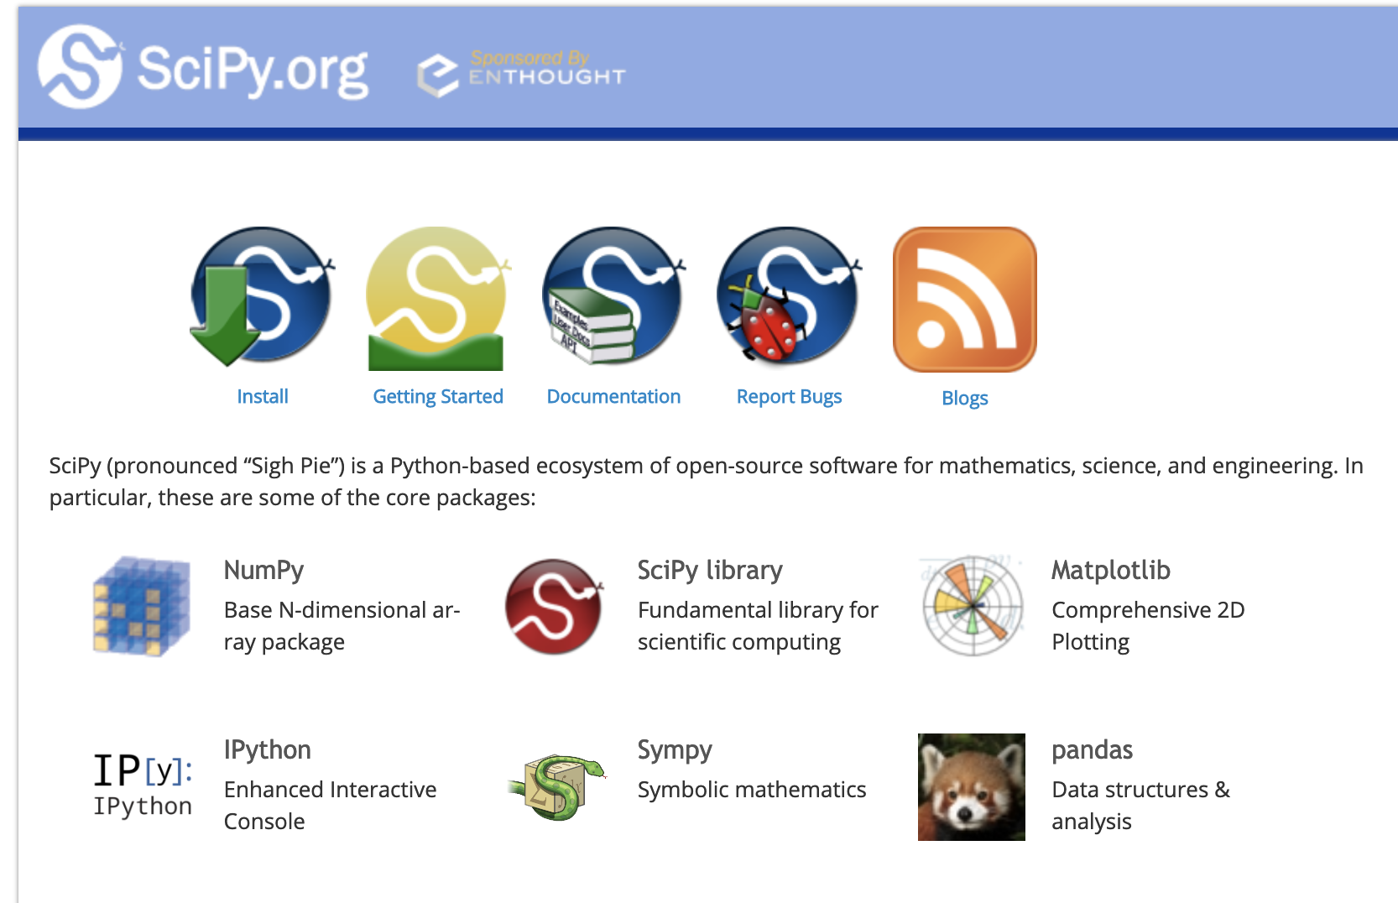
SciPy
SciPy (pronounced “Sigh Pie”) is a Python-based ecosystem of open-source software for mathematics, science, and engineering
Main libraries (packages) include numpy, scipy, matplotlib, ipython, jupyter, pandas, sympy, nose
https://www.scipy.org/

Slide 29
Numpy
Numpy is the fundamental package for scientific computing with Python
A powerful N-dimensional array object
Tools for integrating C/C++ and Fortran code
Useful linear algebra, Fourier transform, and random number capabilities and many, many more

Slide 30
Numpy data types
Type | Python | Numpy | Usage
byte byte array | b‘any string’ bytearray() |  | immutable mutable
integer | int() | 11 types | signed, unsigned 8, 16, 32, 64 bits, unlimited
floating-point | float() | 3 types | 16, 32, 64 bits
complex | complex() | 2 types | 64, 128 bits
unassigned | None |  | object myVar is not None
missing | nan | isnull(), notnull(), isnan() | float, object

Slide 31
Visualisation libraries
matplotlib
histograms
bars
curves
surfaces
contours
maps
legends
annotations
primitives
Seaborn
based on matplotlib
prettier
more informative
more specialised

Slide 32
Lab 2: Python libraries
Read and follow the instructions in the notebook

Slide 33
Questions

Slide 34
Introductory Python for Data Science
Module 3
Data analysis in Python

Slide 35
Agenda
Introduction to data analysis
Data sources and shapes
Data analysis operations
Pandas library
Data loading
Data visualisation
Data statistics
Data insights

Slide 36
Data sources and shapes
Where does data come from?
Databases
Transaction systems
Websites
What data looks like?
Database tables
Spreadsheets
Structured or semi-structured files

Slide 37
Data analysis operations
Wrangling
Sourcing, loading, and precleaning the data so we can see what it really looks like
Profiling
Visualising and understanding the essential characteristics of the data
Munging
reshaping the data to prepare it for analysis

Slide 38
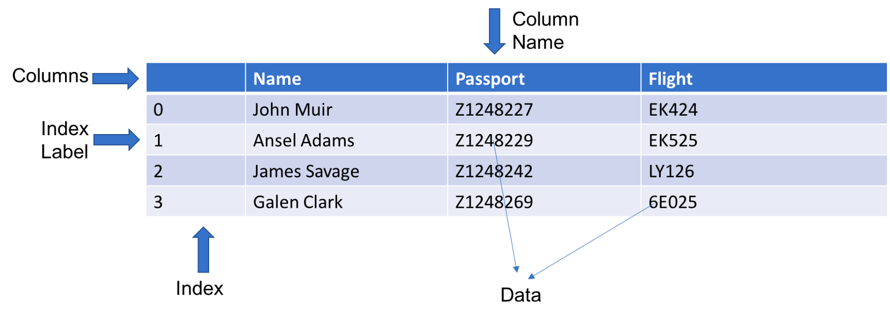
Pandas library
Rich relational data analysis tool built on top of NumPy
Easy to use and highly performing APIs
A foundation for data wrangling, munging, preparation, etc in Python
Pandas Data Frame

Slide 39
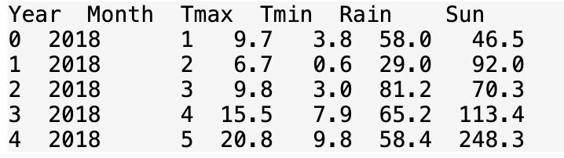
Loading and exploring data
Pandas can load data from many sources including csv files, websites and databases
Pandas load data into a data structure called a Data Frame which looks like a spreadsheet
import numpy as np
import pandas as pd
import matplotlib.pyplot as plt
weather = pd.read_csv('https://raw.githubusercontent.com/alanjones2/dataviz/master/london2018.csv')
print(weather.head())

Slide 40
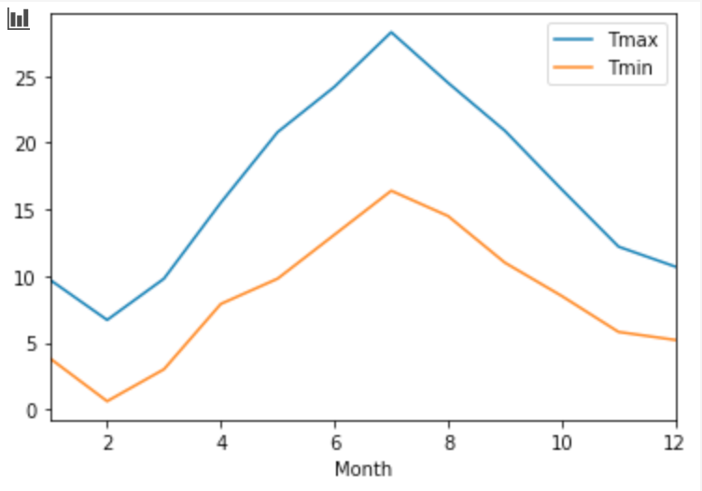
Data visualisation
Data can be plotted directly from pandas’ data frames using matplotlib
There are many plot types available including:
Line chart
Bar chart
Scatter plot
Pie chart
Histograms
etc
weather.plot(y=['Tmax','Tmin'], x='Month')

Slide 41
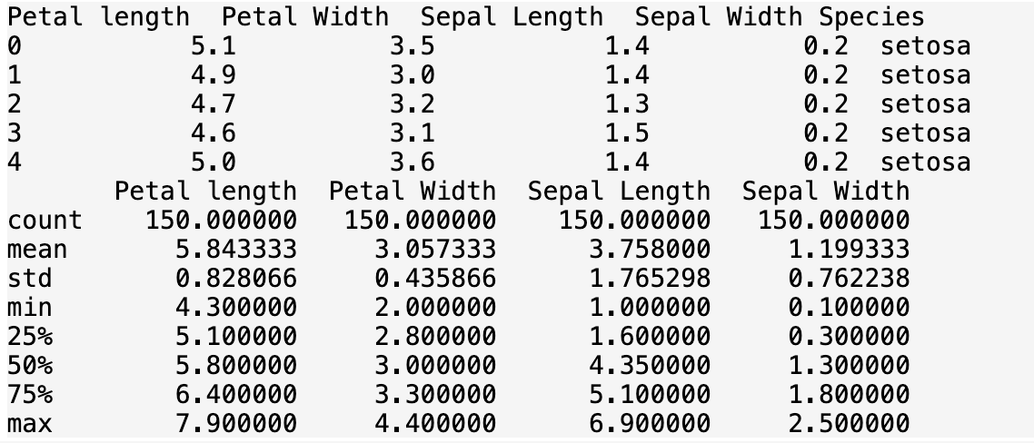
Data statistics
Pandas provides many functions that allow you to explore statistics of the data including:
Count
Mean
Standard deviation
Minimum
Maximum
from sklearn.datasets import load_iris
dataset=load_iris()
data=pd.DataFrame(dataset["data"],columns=["Petal length","Petal Width","Sepal Length","Sepal Width"])
data["Species"]=dataset["target"]
data["Species"]=data["Species"].apply(lambda x: dataset["target_names"][x])
print(data.head())
print(data.describe())

Slide 42
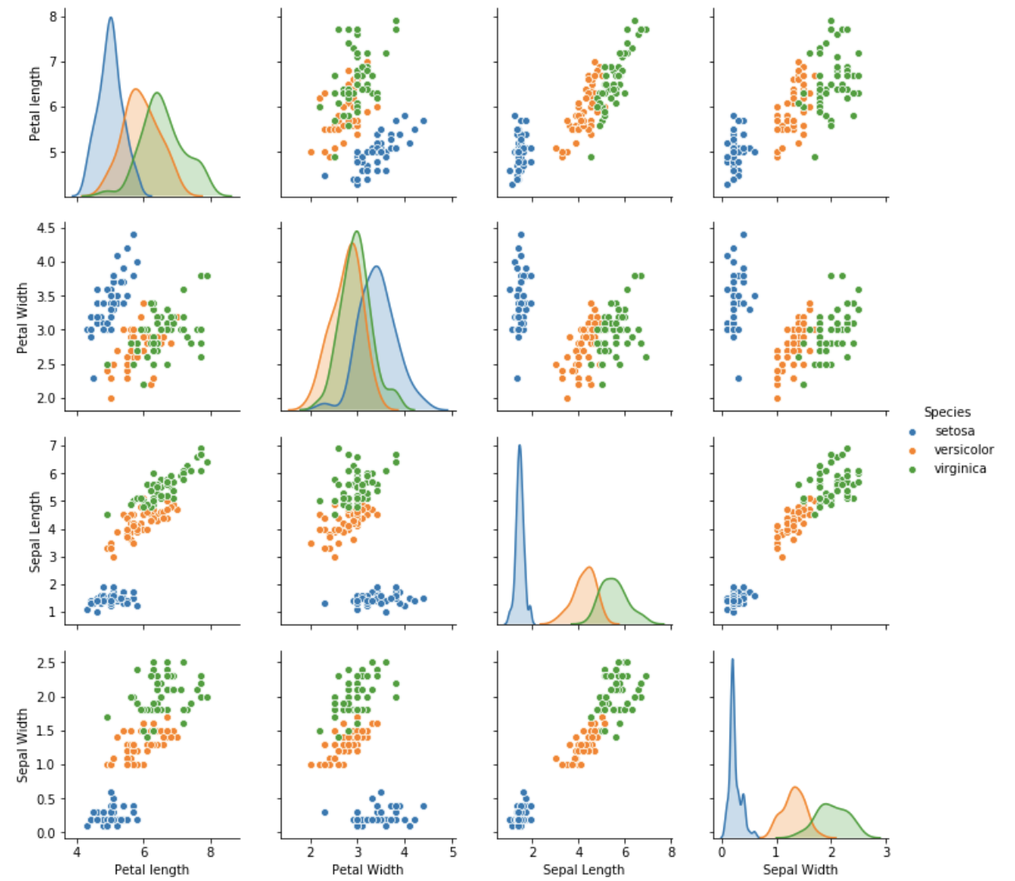
Analytical insights
Using pandas, numpy and matplotlib you can not just describe and visualise the data. You can obtain insights that show deeper relationships between various data elements.
sns.pairplot(data, hue="Species")

Slide 43
Lab 3: Data analysis in Python
Read and follow the instructions in the notebook

Slide 44
Questions

Slide 45
Introductory Python for Data Science
Module 4
Summary and call for action

Slide 46
Summary and call for action
We explored what is programming and how it can be viewed as a problem-solving technique.
We introduced Python as a suitable programming language for implementing data science projects
We applied programming and data analysis techniques in a number of lab exercises that hopefully gave you a flavour of how data analysts, scientists and engineers use Python to perform data-driven projects.

Slide 47
Questions

Slide 48
End of presentation

